Slide 1
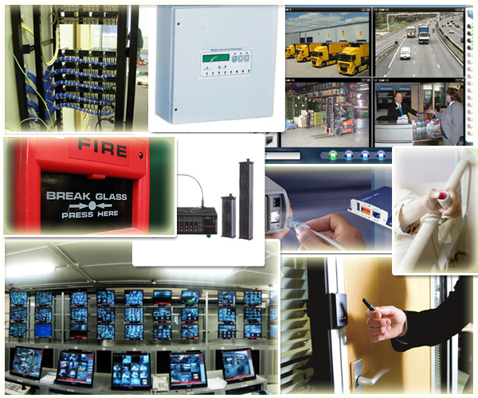

BIRLAMEDISOFT
We Care Health Care…
Presents
ELV
Extremely Low Voltage Systems

Slide 2
Modules Covered
1. Structured Cabling for Data and Voice
2 . Access Control System
3. IP Video Surveillance System
4. Nurse Call System
5. Water Leaking Detection System
6. Fire Alarm System
7. Public Address System
8. Integrated Building Management System
www.birlamedisoft.com

Slide 3
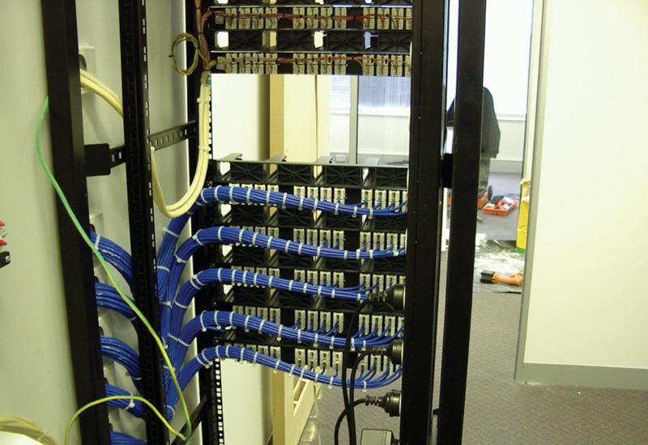
Structured Cabling for Data and Voice
www.birlamedisoft.com

Slide 4
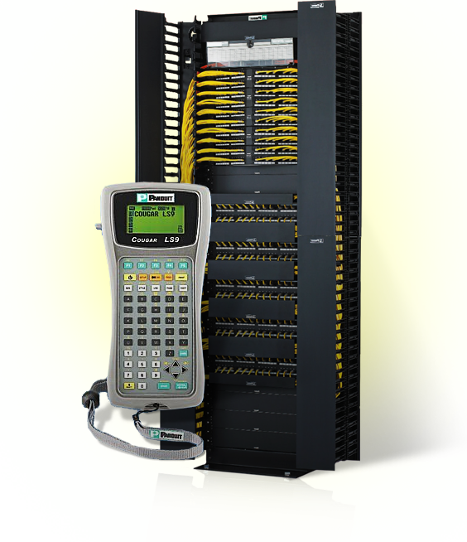
Introduction to Structured Cabling System
A Structured Cabling System is a cabling and connectivity products that integrates data, voice, video and various management system of a building
www.birlamedisoft.com

Slide 5
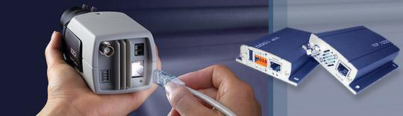
Structured Cabling System Description
Structured cabling is a system that can support the combined use of voice and data within the same network using the same network cable. This cabling system is designed to be installed using a "flood wiring" approach.
The use of "flood wiring" should ensure that all possible locations of premises, (subject to the customer’s requirements) that can be occupied by a user is covered by the structured data cabling. If planned correctly "flood wiring" should prevent any further data cabling from being necessary when adding new users or relocating existing ones.
Because of this systems flexibility to support voice and data at whatever location, structured cabling will not only future proof your premises
www.birlamedisoft.com

Slide 6
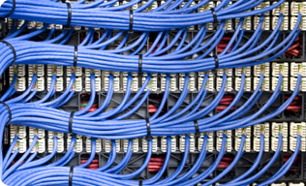
Benefits of Structured Cabling System
Redundancy at design stage reduces downtime & repair time
Concealed cabling
Ease of fault location & repair
Flexibility, expandability & modular connecting platform
Ease of moves, adds and changes
Enhanced end-use understanding and control
Continuous product support and warranty
Significant long term cost containment
www.birlamedisoft.com

Slide 7
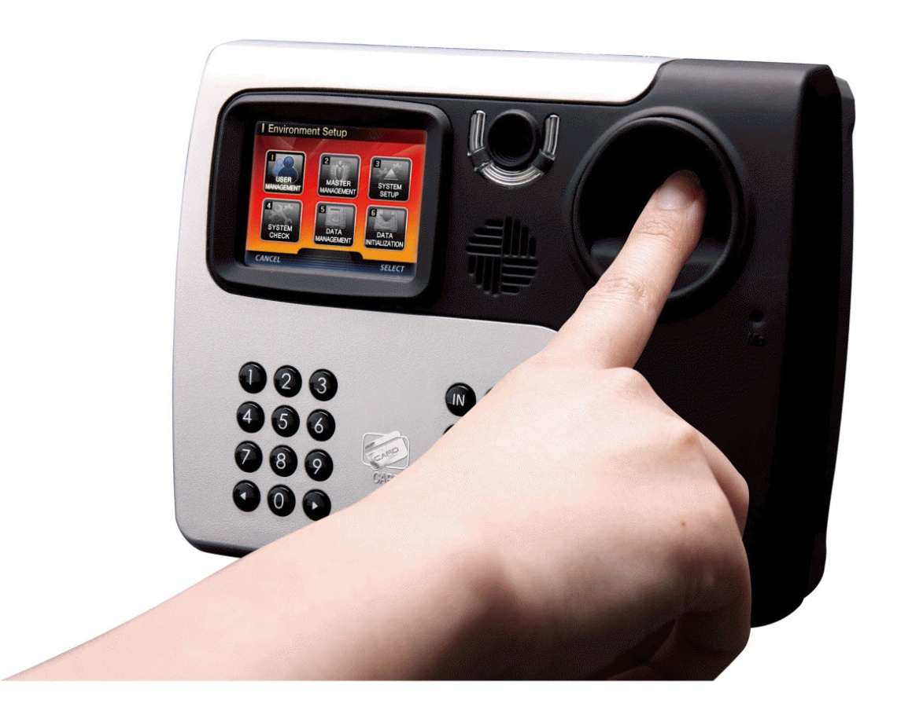
Access Control System
www.birlamedisoft.com

Slide 8

Access Control Introduction
Access control is the collection of mechanisms that permits managers of a system to exercise a directing or restraining influence over the behavior, use, and content of a system. It permits management to specify what users can do, which resources they can access, and what operations they can perform on a system.
The three main security principles pertaining to access control are:
Availability
Integrity
Confidentiality
Identification, Authentication, and Authorization are distinct functions.
www.birlamedisoft.com

Slide 9
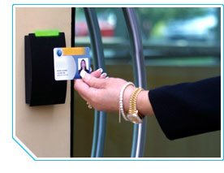
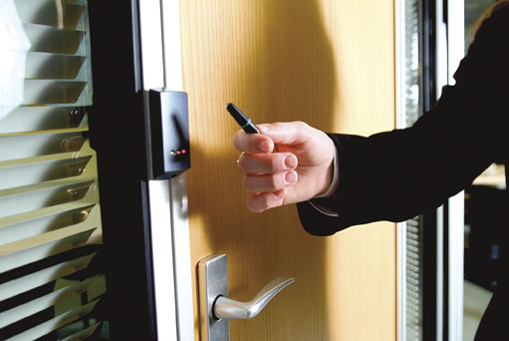
Identification
Identification :
Method of establishing the subject’s (user, program, process) identity.
Use of user name or other public information.
Know identification component requirements.
www.birlamedisoft.com

Slide 10
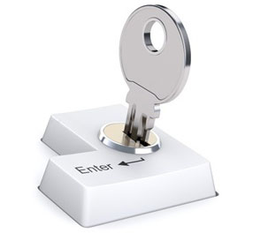
Authentication
Authentication: Method of proving the identity.
Something a person is, has, or does.
Use of biometrics, passwords, passphrase, token, or other private information.
Strong Authentication is important
Biometrics : Verifies an identity by analyzing a unique person attribute or behavior (e.g., what a person “is”).
Most expensive way to prove identity, also has difficulties with user acceptance.
Many different types of biometric systems, know the most common.
Most common biometric systems:
Fingerprint
Palm Scan
Hand Geometry
Iris Scan
Signature Dynamics
Keyboard Dynamics
Voice Print
Facial Scan
Hand Topography
Passwords : User name + password is the most common identification, authentication scheme.
www.birlamedisoft.com

Slide 11

Authorization
Authorization : Determines that the proven identity has some set of characteristics associated with it that gives it the right to access the requested resources.
Access Criteria can be thought of as:
Roles
Groups
Location
Time
Transaction Types
Authorization concepts to keep in mind:
Authorization Creep
Default to Zero
Need to Know Principle
Access Control Lists
Problems in controlling access to assets:
Different levels of users with different levels of access
Resources may be classified differently
Diverse identity data
Corporate environments keep changing
www.birlamedisoft.com

Slide 12

Access Control Models
Three Main Types:
Discretionary : A system that uses discretionary access control allows the owner of the resource to specify which subjects can access which resources.
Access control is at the discretion of the owner.
Mandatory : Access control is based on a security labeling system. Users have security clearances and resources have security labels that contain data classifications.
This model is used in environments where information classification and confidentiality is very important (e.g., the military).
Non-Discretionary (Role Based) : Role Based Access Control (RBAC) uses a centrally administered set of controls to determine how subjects and objects interact. Is the best system for an organization that has high turnover.
www.birlamedisoft.com

Slide 13
Access Control Techniques
There are a number of different access controls and technologies available to support the different models.
Rule Based Access Control
Uses specific rules that indicate what can and cannot happen between a subject and an object.
Not necessarily identity based.
Traditionally, rule based access control has been used in MAC systems as an enforcement mechanism.
Constrained User Interfaces:
Restrict user’s access abilities by not allowing them certain types of access, or the ability to request certain functions or information
Access Control Matrix:
Is a table of subjects and objects indicating what actions individual subjects can take upon individual objects.
Content Dependent Access Control:
Access to an object is determined by the content within the object.
Context Based Access Control:
Makes access decision based on the context of a collection of information rather than content within an object.
www.birlamedisoft.com

Slide 14

Access Control Administration
First an organization must choose the access control model (DAC, MAC, RBAC).
Then the organization must select and implement different access control technologies.
Access Control Administration comes in two basic forms:
Centralized : One entity is responsible for overseeing access to all corporate resources.
Provides a consistent and uniform method of controlling access rights.
Protocols: Agreed upon ways of communication
Attribute Value Pairs: Defined fields that accept certain values.
Decentralized :
Gives control of access to the people who are closer to the resources
Has no methods for consistent control, lacks proper consistency.
www.birlamedisoft.com

Slide 15
Access Control Methods
Access controls can be implemented at various layers of an organization, network, and individual systems
Three broad categories:
Administrative
Physical
Technical (aka Logical)
Administrative Controls
Policy and Procedure
Personnel Controls
Separation of Duties
Rotation of Duties
Mandatory Vacation
Supervisory Structure
Security Awareness Training
Testing
Physical Controls
Network Segregation
Perimeter Security
Computer Controls
Work Area Separation
Data Backups
Cabling
Control Zone
Technical (Logical) Controls
System Access
Network Architecture
Network Access
Encryption and protocols
Auditing
www.birlamedisoft.com

Slide 16
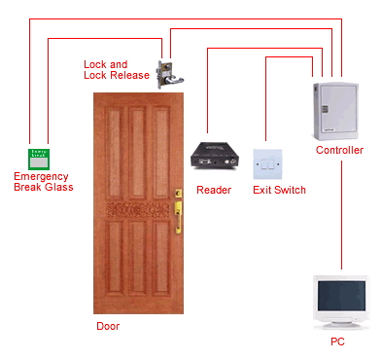
Access Control Monitoring
Intrusion Detection
Three Common Components
Sensors
Analyzers
Administrator Interfaces
Common Types
Intrusion Detection
Intrusion Prevention
Honeypots
Network Sniffers
Two Main Types of Intrusion Detection Systems
Network Based (NIDS)
Host Based (HIDS)
HIDS and NIDS can be:
Signature Based
Statistical Anomaly Based
Protocol Anomaly Based
Traffic Anomaly Based
Rule Based
www.birlamedisoft.com

Slide 17
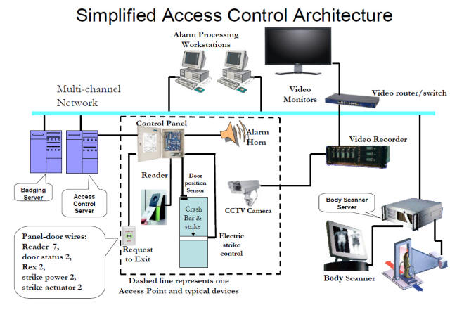
www.birlamedisoft.com

Slide 18
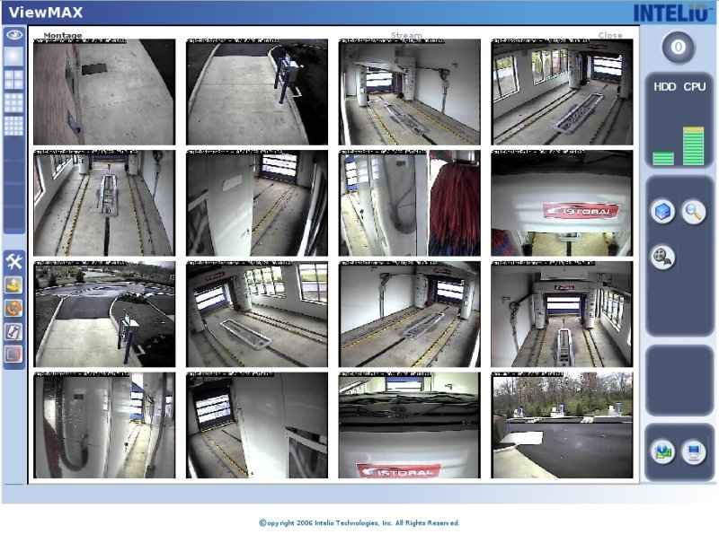
IP Video Surveillance
www.birlamedisoft.com

Slide 19
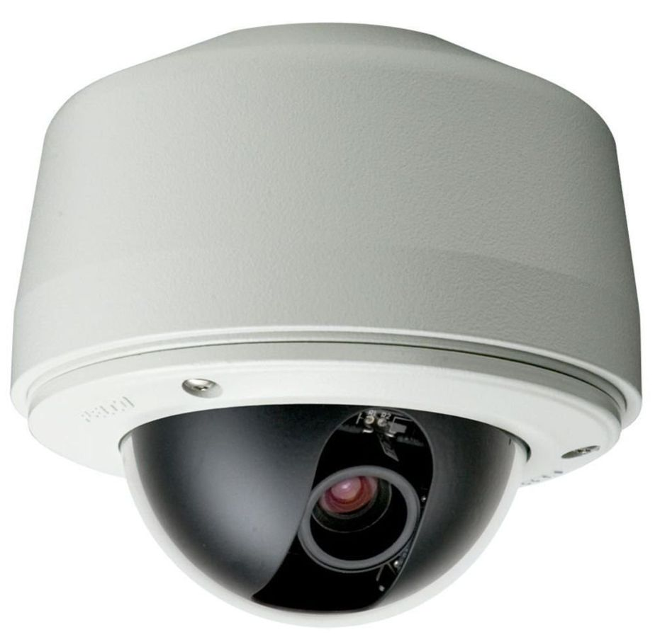
IP Video Surveillance System Introduction
Closed-circuit television (CCTV) is the use of video cameras to transmit a signal to a specific, limited set of monitors. It differs from broadcast television in that the signal is not openly transmitted, though it may employ point wireless links. CCTV is often used for surveillance in areas, which need security, such as banks, casinos, airports etc. Modern CCTV cameras use small high definition color cameras that can not only focus to resolve minute detail, but by linking the control of the cameras to a computer, objects can be tracked automatically
www.birlamedisoft.com

Slide 20
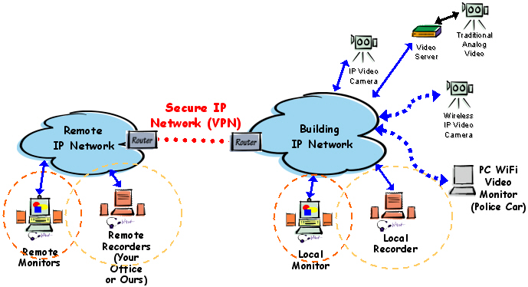
IP Video Surveillance Architecture
www.birlamedisoft.com

Slide 21
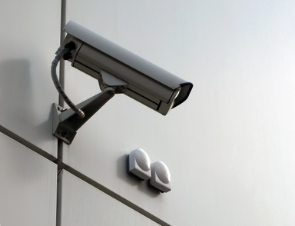
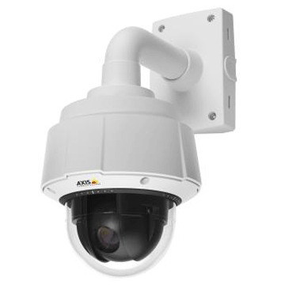
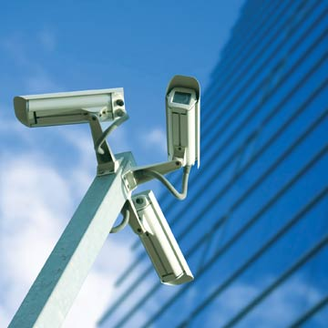
Kinds of IP Cameras
An Internet protocol camera, or IP camera, is a type of digital video camera commonly employed for surveillance, and which unlike analog closed circuit television (CCTV) cameras can send and receive data via a computer network and the Internet. Although most cameras that do this are webcams, the term "IP camera" or "netcam" is usually applied only to those used for surveillance.
There are two kinds of IP cameras:
Centralized IP cameras, which require a central Network Video Recorder (NVR) to handle the recording, video and alarm management.
Decentralized IP cameras, which do not require a central Network Video Recorder (NVR), as the cameras have recording functionality built-in and can thus record directly to digital storage media, such as flash drives, hard disk drives or network attached storage.
www.birlamedisoft.com

Slide 22
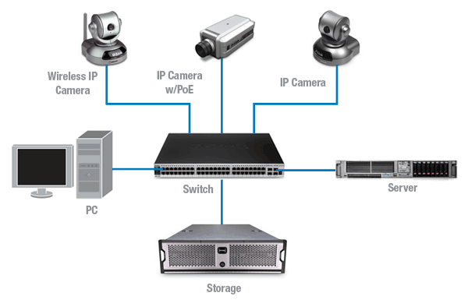
Working of IP Surveillance System
www.birlamedisoft.com

Slide 23
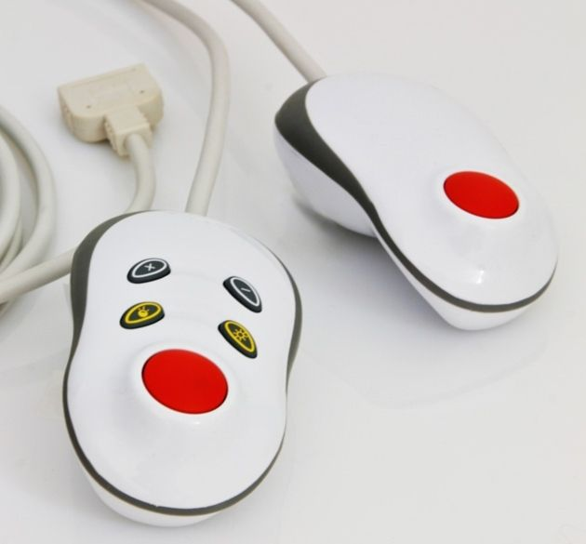
Nurse Call System
www.birlamedisoft.com

Slide 24
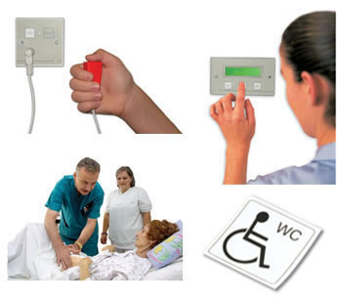
Features of Nurse Call System
Integrates with the best-selling digital telephone systems.
Text messaging for nurse call.
Unified, scalable architecture grows with your healthcare enterprise
Advanced technology provides high-quality communication.
Safe, low power operation does not interfere with medical equipment.
No monthly airtime or usage charges.
www.birlamedisoft.com

Slide 25
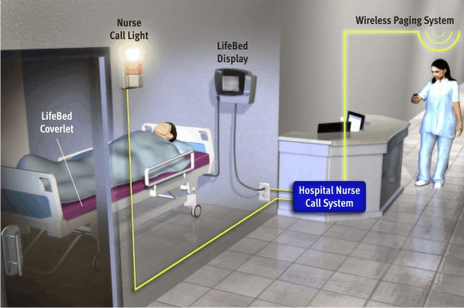
Diagrammatic Representation of Nurse Call System
www.birlamedisoft.com

Slide 26
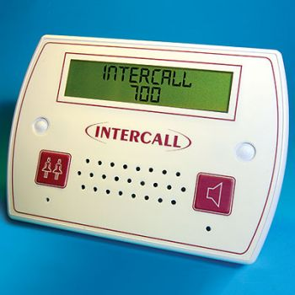
Capabilities of Nurse Call System
Capabilities
Immediate text display: patient, room info and call status
Single button connects nurse to patient
Auto-forwarding to alternate nurse
Auto-delivery by shift from nurse master station
www.birlamedisoft.com

Slide 27
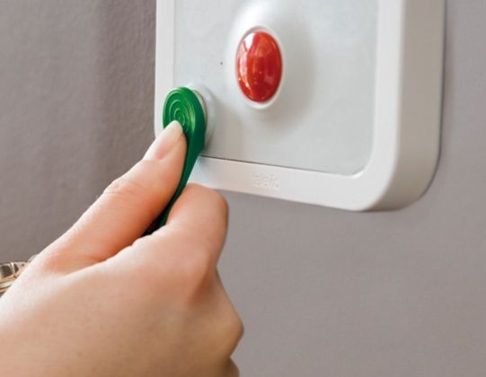
Advantages of Nurse Call System
Patients
Higher level of care and faster recovery
Nurses
More time with patients, and better patient care
Physicians
Direct access to nurses
Emergency department
Faster response and increased efficiency
Specialties and support staff
Coordinate efforts with other staff to improve productivity
www.birlamedisoft.com

Slide 28
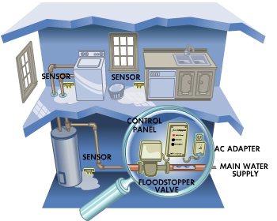
Water Leaking Detection System
www.birlamedisoft.com

Slide 29
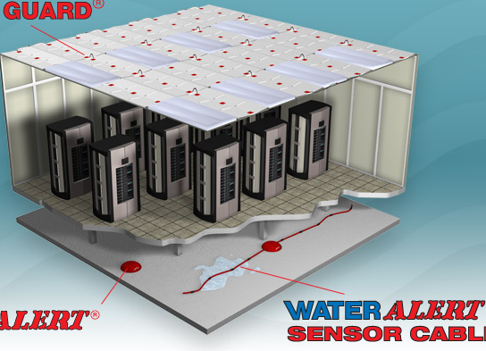
Introduction to Water Leak Detection System
Water Leak Detection System is used for integrated systems installed in "high-tech" buildings or those containing valuable artifacts, materials or other assets where early notification of a potentially damaging leak would be beneficial.
Leak detection systems must be unobtrusive, effective and robust enough to withstand getting dirty and the moderate physical abuse of other works being carried out under the same floor.
Zoned systems have a reputation for being safe, reliable and not prone to the same types of false alarms which those systems which use cumulative resistance techniques.
www.birlamedisoft.com

Slide 30
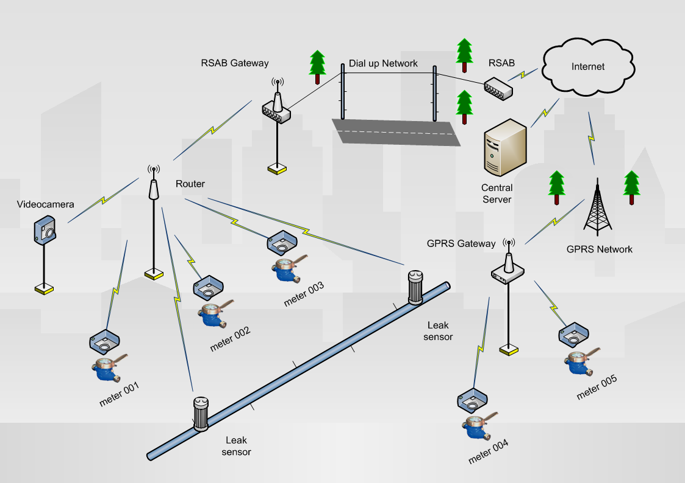
Architecture of Water Leaking Detection System
www.birlamedisoft.com

Slide 31
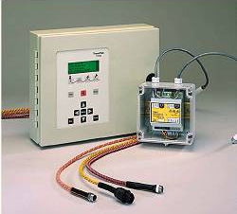
Working of Water Leaking Detection System
The water leak detector cable.
The cable itself is the sensor. Every centimetre of rugged, fire rated cable is sensitive to water and when water comes into contact with the cable, the system is able to detect the leak & report the location.
The detection cable can be installed in any length from a few metres in a drip tray to hundreds of metres around the perimeter of an office area. Typical applications in office buildings include the monitoring of fan-coil units around the edge of the building office floors, detectors surrounding the central utility core on each floor of the building and dedicated monitoring of leaks in electrical switch gear rooms, server rooms, network communications, etc. Each section of sensor cable is monitored by an inexpensive Sensor Interface Module. Various models are available with and without relay contacts and digital displays, but all modules are easily networked back to a central alarm panel or interfaced directly to the LAN as easy to design and install as a simple water leak detection system for one or two rooms or as a major installation in industrial complexes and high rise buildings.
www.birlamedisoft.com

Slide 32
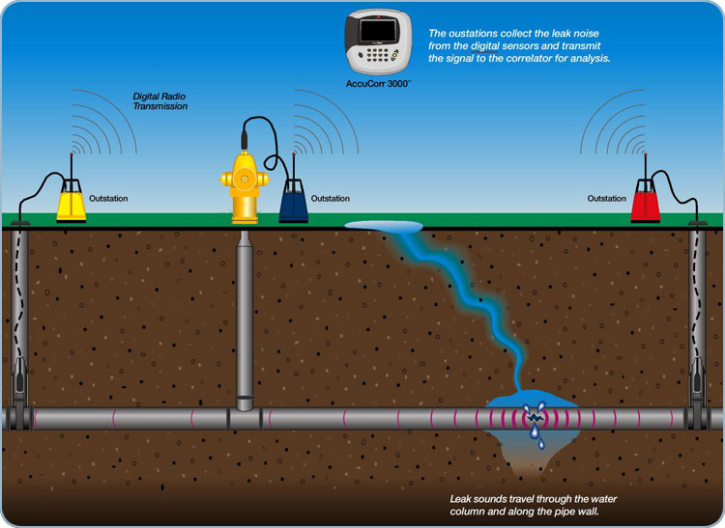
Diagram of Water Leaking Detection System
www.birlamedisoft.com

Slide 33
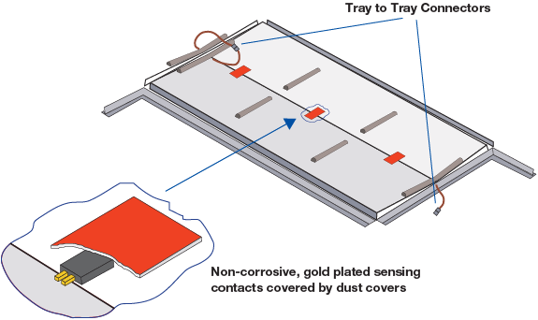
Benefits of Water Leaking Detection System
• Improved operational efficiency.
• Lowered water system operational costs.
• Reduced potential for contamination.
• Extended life of facilities.
• Reduced potential property damage and water system liability.
• Reduced water outage events.
• Improved public relations.
www.birlamedisoft.com

Slide 34
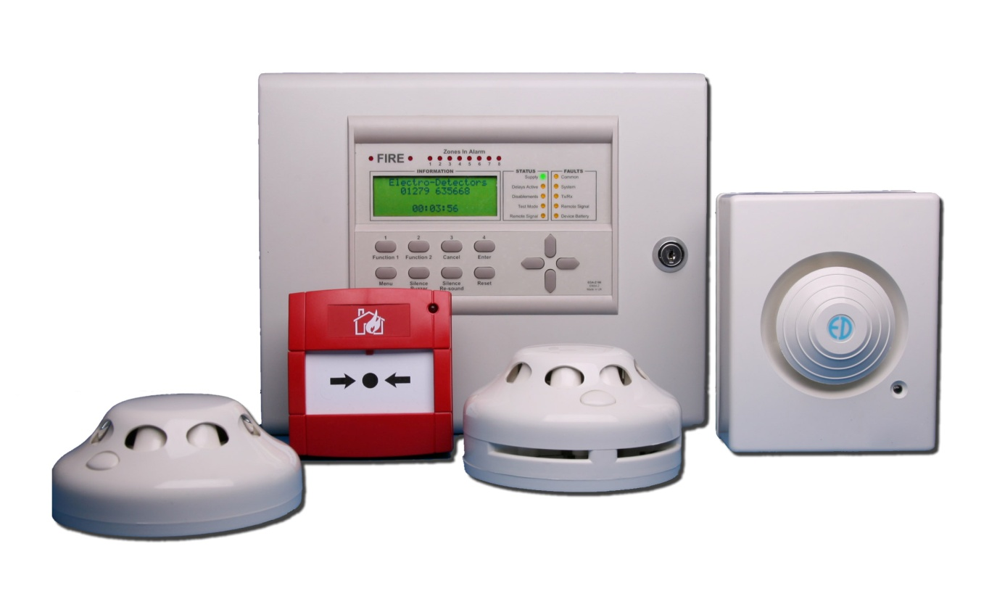
Fire Alarm System
www.birlamedisoft.com

Slide 35

Fire Alarm System Introduction
An automatic fire alarm system is designed to detect the unwanted presence of fire by monitoring environmental changes associated with combustion. In general, a fire alarm system is classified as either automatically actuated, manually actuated, or both. Automatic fire alarm systems are intended to notify the building occupants to evacuate in the event of a fire or other emergency, report the event to an off-premises location in order to summon emergency services, and to prepare the structure and associated systems to control the spread of fire and smoke.
www.birlamedisoft.com

Slide 36
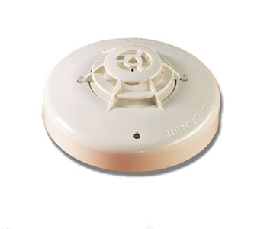
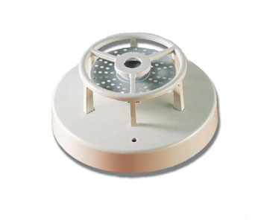
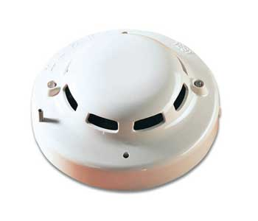
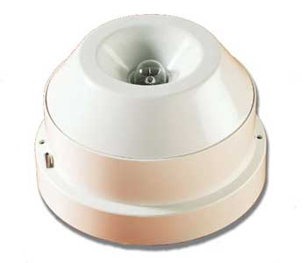
Fire Alarm System Features
A key aspect of fire protection is to identify a developing fire emergency in a timely manner, and to alert the building's occupants and fire emergency organizations.
This is the role of fire detection and alarm systems. Depending on the anticipated fire scenario, building and use type, number and type of occupants and criticality of contents and mission, these systems can provide several main functions:
First, they provide a means to identify a developing fire through either manual or automatic methods.
Second, they alert building occupants to a fire condition and the need to evacuate.
Another common function is the transmission of an alarm notification signal to the fire department or other emergency response organization.
They may also shut down electrical, air handling equipment or special process operations, and they may be used to initiate automatic suppression systems.
www.birlamedisoft.com

Slide 37
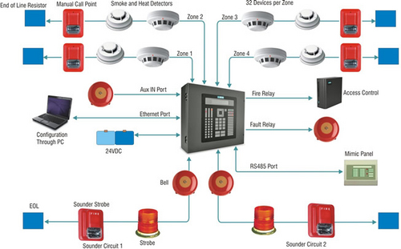
Fire Alarm System Configuration
www.birlamedisoft.com

Slide 38
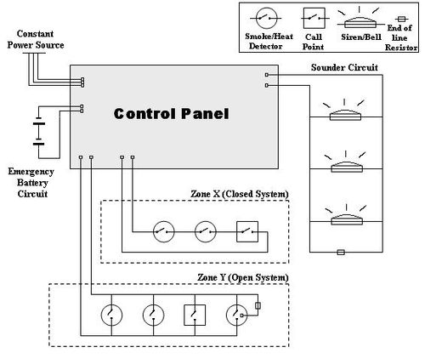
Architecture of Fire Alarm System
www.birlamedisoft.com

Slide 39
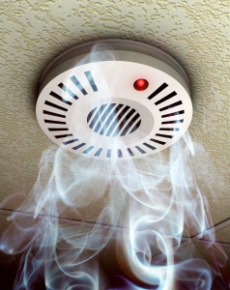
Benefits of Fire Alarm System
The main advantage of installing fire alarms is the early warning benefit. The fire alarms can be installed just about any where in a commercial building and best of all the fire safety measure is highly cost effective for smoke and fire protection.
Early warning is essential to effective fire safety because fires can occur anytime and any place. We highly recommend having fire alarms installed on every floor of your commercial business because a fire can ignite even when people are not within a room or section of the building.
You can be immediately alerted of a fire at your commercial building when your fire alarm system is connected to a remote monitoring station. This early warning signal is extremely important to life safety for the following reasons:
Increases evacuation time for building occupants before a fire spreads out of control.
Emergency medical help can be immediately sent out to those in need.
Fire department personnel can help people exit the building safely.
Easier to install.
More system status information at the panel and central station.
Input / Output programming much more flexible.
Usually much more room available to expand.
www.birlamedisoft.com

Slide 40
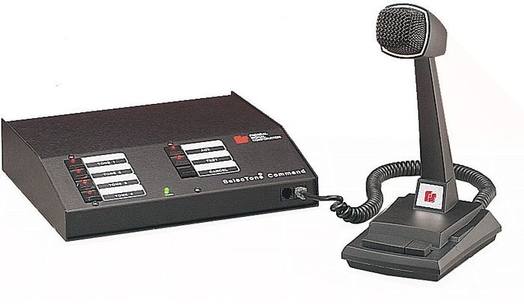
Public Address System
www.birlamedisoft.com

Slide 41
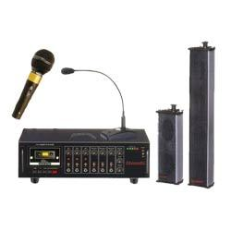
Public Address System Introduction
A public address system (PA system) is an electronic sound amplification and distribution system with a microphone, amplifier and loudspeakers, used to allow a person to address a large public, for example for announcements of movements at large and noisy air and rail terminals.
The term is also used for systems which may additionally have a mixing console, and amplifiers and loudspeakers suitable for music as well as speech, used to reinforce a sound source, such as recorded music or a person giving a speech or distributing the sound throughout a venue or building.
www.birlamedisoft.com

Slide 42
Components of a Public Address System
Sound sources: equipment that generates sound as an analogue, electrical or digital signal. Examples include microphones, CD players, electric guitars, synthesizers and samplers.
A mixing desk: a device with which to control, balance and treat the various sound sources. The mixer may have a series of inputs which allow most types of sound sources to be connected and routed to the next part of the signal chain.
Signal processors: devices used to treat or manipulate the signal from the sound sources so as to make it conform to the desired effect. Examples include compressors, reverb units and equalizers. Some of these may be in the mixing desk and some may be external devices.
Amplifiers: devices designed to increase the level of the mixed and treated signals to the point at which they can be transmitted to a loudspeaker to create sufficient volume.
Loudspeakers (or speakers): these convert the electrical signal from an amplifier into sound waves and direct the resultant sound into the auditorium.
www.birlamedisoft.com

Slide 43
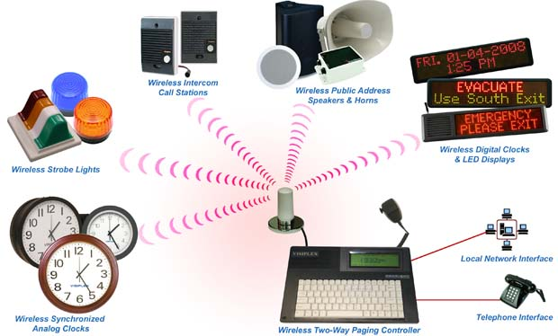
Working of Public Address System
www.birlamedisoft.com

Slide 44
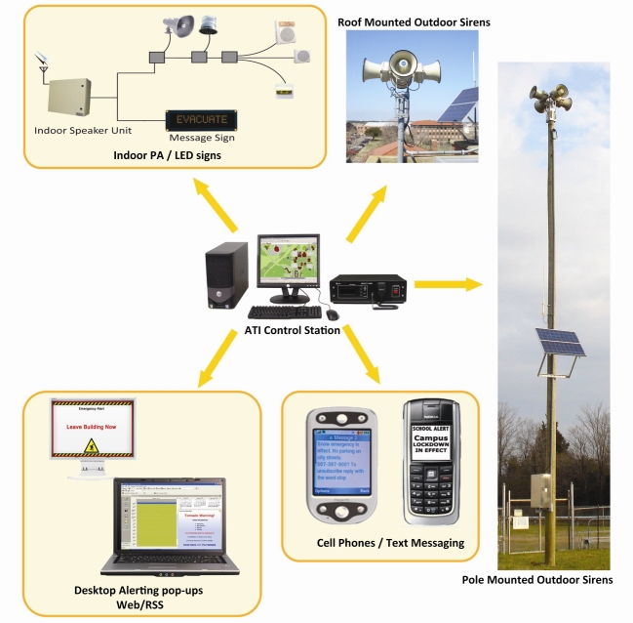
Configuration of Public Address System
www.birlamedisoft.com

Slide 45
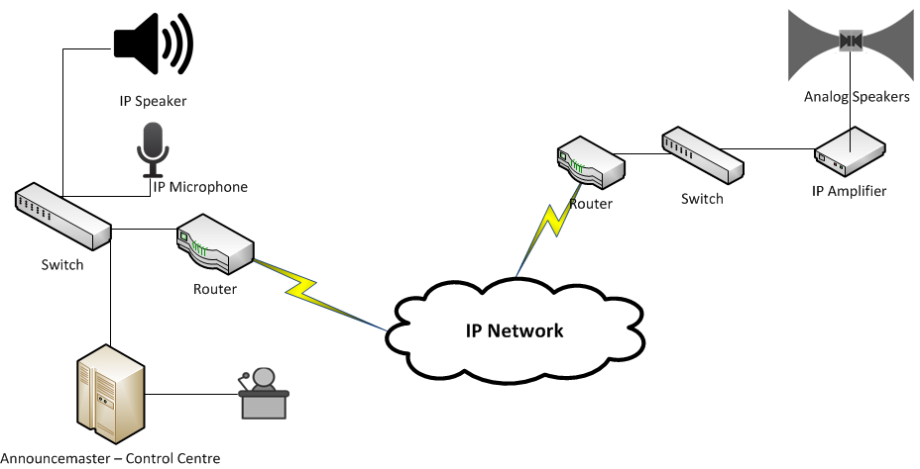
Architecture of Public Address System
www.birlamedisoft.com

Slide 46
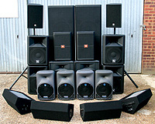
Benefits of Public Address System
Reduced and easy maintenance
Simple, reduced and economical field cabling
Trouble free system
Flexibility to connect the loudspeakers at longer distance.
Modular architecture
Flexibility to build the system for the present need with enough provision for future expansion.
Connectivity of P.A. system with the EPABX System
Monitoring the healthiness of all associated equipment in the PA System
Call attention chime tone prior to all announcements
Facility of connecting emergency siren over the paging channel
No use of AC Power source in the field
Highest priority for control desk paging
Bass and Treble control to custom-tailor the frequency response, for poor acoustic or highly noisy environments
LED Bar graph in dB scale to read the relative power
Distribution of audio signal through buffered O/P
www.birlamedisoft.com

Slide 47
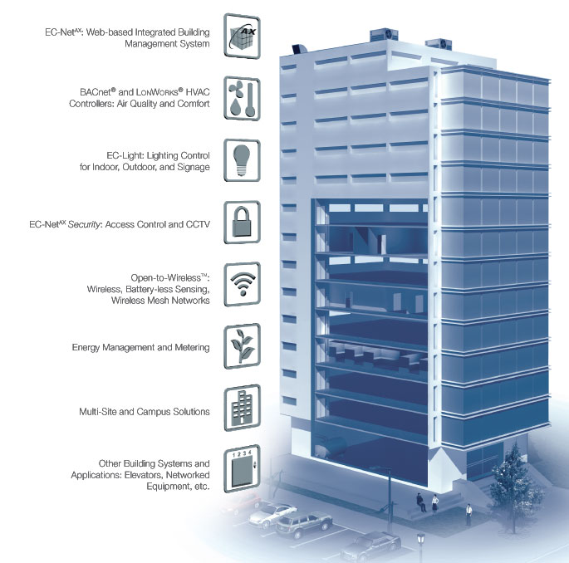
Integrated Building Management System
www.birlamedisoft.com

Slide 48
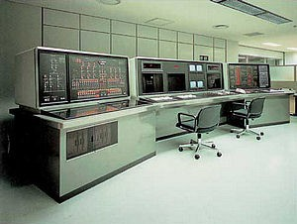
Integrated Building Management System
All Buildings have some form of mechanical and electrical services in order to provide the facilities necessary for maintaining a comfortable working environment. These services have to be controlled by some means to ensure comfort conditions. Basic controls take the form of manual switching, time clocks or temperature switches. Here if Integrated Building Management System (BMS), is introduced, we are able to get a comfortable working environment in an efficient way.
www.birlamedisoft.com

Slide 49
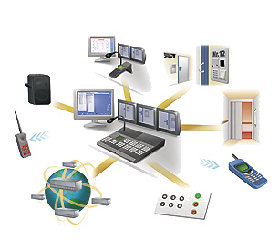
Features of Building Management System
Central controlling facility
Automate and take control of various operations
Manage and Coordinate the various systems
Provide a comfortable working environment in an efficient way.
Its purpose is to control, monitor and optimize building services
E.g., lighting; heating & cooling; security ; audio-visual and entertainment systems; ventilation and climate control; time & attendance control and reporting
www.birlamedisoft.com

Slide 50
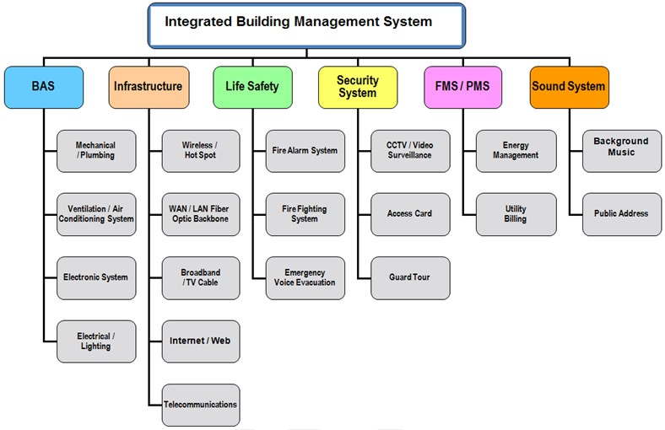
Modules integrated into Building Management System
www.birlamedisoft.com

Slide 51
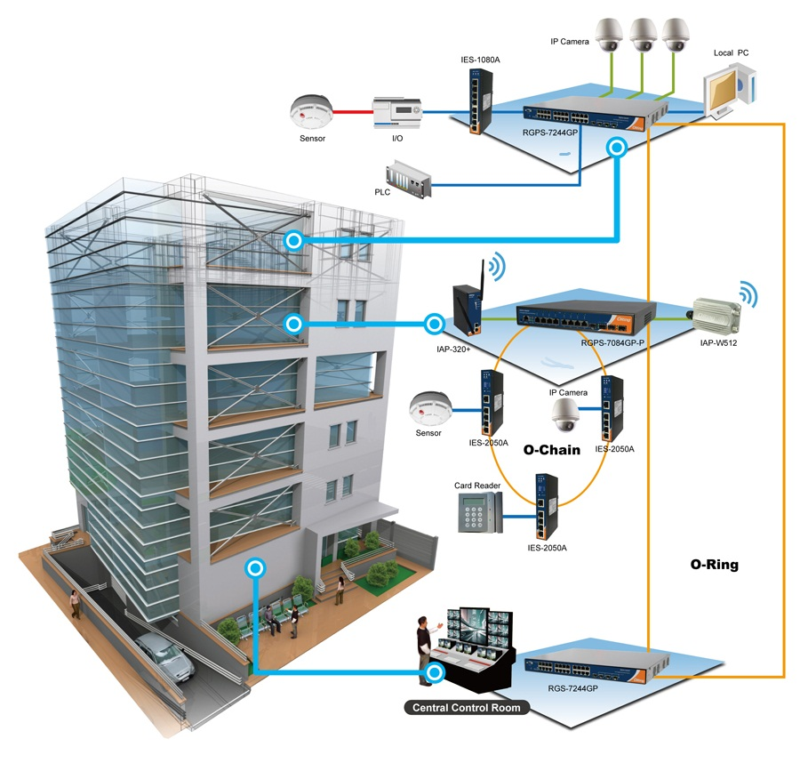
Architecture of Building Management System
www.birlamedisoft.com

Slide 52
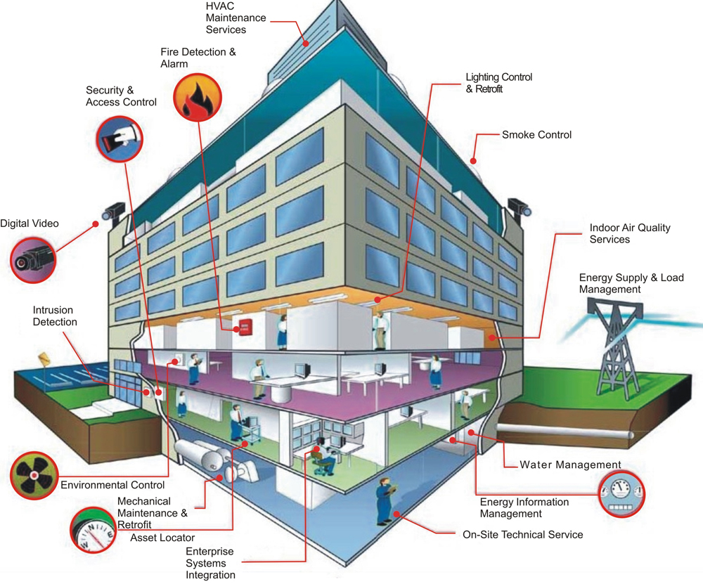
Building Management System - Connectivity
www.birlamedisoft.com

Slide 53
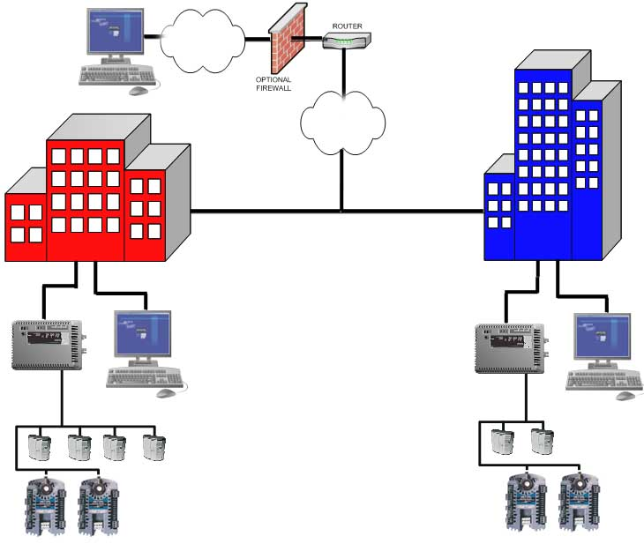
Configuration of Building Management System
www.birlamedisoft.com

Slide 54

Advantages of Building Management System
With the usage of various building automation techniques the energy efficiency is possible
With the help of occupancy sensors provided in various areas of the building, the service plants can be brought into operation only when needed and also to the optimum, thereby leading to huge energy savings
BMS improves quality of built environment, efficiency of workstations, while allowing great savings in energy consumption
Provide an acceptable level of temperature and humidity and safe guard against odours and indoor air pollutants.
Life safety factors involved in Intelligent Buildings are:
Closed-circuit television
Card access control
Smoke detection
Emergency control of elevator, doors ,HVAC system
UPS
‘Data access’ security
www.birlamedisoft.com

Slide 55


Corporate Office : Birlamedisoft Pvt. Ltd. 111 , 311 & 411, Gulmohar Centre Point, Pune Nagar Road, Near Vibhute Hospital, Opp. Kothari Wheels Maruti Showroom, Pune 411014, INDIA. Toll Free No: 1-800-3070-2090 Global Contact No. : +91 9021 156 156 Customer Support : Cell : +91-92256 22058, +91-92256 22059 , +91-92255 62180 Landline : +91-20-65106272 Email : support@birlamedisoft.com Sales Enquiry : Cell : +91-98232 90336, +91-94031 36401 / 402 / 403 , +91-9225061528 Landlines : +91-20-20261169, +91-20-20261171/72 , +91-20-65106271 / 72 / 73 Fax : +91-20-27036459 Email: info@birlamedisoft.com, birlamedisoft@gmail.com (General info / Sales) Skype : Birlamedisoft Website : www.birlamedisoft.com
Contact Us
www.birlamedisoft.com

Slide 56

Thank You!
www.birlamedisoft.com

